Slide 1
Home Credit Default Risk
Prepared by: Ahmed Elbaz

Slide 2
Overview
Home Credit strives to broaden financial inclusion for the unbanked population by providing a positive and safe borrowing experience.
In order to make sure this underserved population has a positive loan experience, Home Credit makes use of a variety of alternative data--including telco and transactional information--to predict their clients' repayment abilities.
In this challenge we will help them in unlocking the full potential of their data to ensure that clients capable of repayment are not rejected.
Performance Metric used in this challenge is area under the ROC curve between the predicted probability and the observed target.

Slide 3
Approach
I’ve tried the below approach to solve this problem:
1
First of all during training I used only application_train.csv file noting that merging the other data sources would enhance the final findings.
2
Through Exploratory Data Analysis I found that data is highly imbalanced and features with the highest null values located. I decided to avoid dropping any feature and selected median to impute the null values.
3
As a data preprocessing step categorical features were converted to numerical values using one-hot encoder which lead to increment in number of features but as we already worked in only one csv the total number of features wasn’t that high(242) I tried to use PCA dimensionality reduction technique but didn’t show remarkable improvement.

Slide 4
Approach(cont.d)
Also SMOTE technique was used to upsample the minority class but it didn’t show obvious change in the final score so I decided to work with the original data.
4
In Model selection I tried to keep it simple at the beginning of classification problem and used logistic regression, naïve bayes, Random Forest, XGBOOST and LightGBM. I finally found that XGBOOST with some hyperparameter tuning using Randomized Search performed the best.
5
6
Increasing training data used by merging the training data from other sources would enhance the results. Further tuning of LightGBM would also improve the final results noting that after carful reading I decided not to use any neural networks algorithms as XGBOOST and LightGBM worked the best for most challengers. However, I’d try some NNs If I have more time.

Slide 5
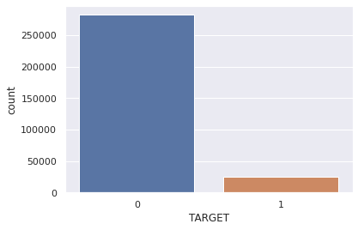
Exploratory Data Analysis
When we checked the TARGET column we found it highly imbalanced as number of clients in training data that paid successfully is much greater than the clients failed to pay for some reason.
This is normal for these kind of problems to have data biased toward one of the 2 classes.
Because of Data imbalance accuracy wasn’t selected as evaluation metric and area under ROC curve selected instead.

Slide 6
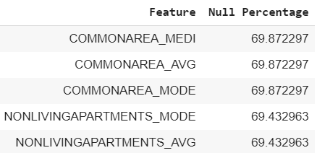
Exploratory Data Analysis(cont.d)
For Null values analysis we found that for some features null values represent about 70% of the data.
While the values of nulls are high for some features I decided to avoid removing certain columns and impute the missing values with median

Slide 7
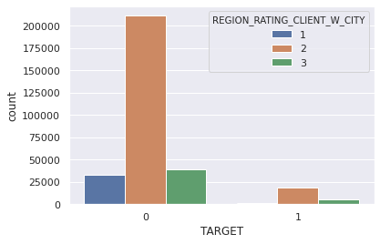
Exploratory Data Analysis(cont.d)
I used correlation to check the linear relation between different features and target and found that age of client affects whether he will be able to pay or not.
Also we found that clients in region 1 which is rated by Home Credit almost never have any payment difficulties as shown in this plot.

Slide 8
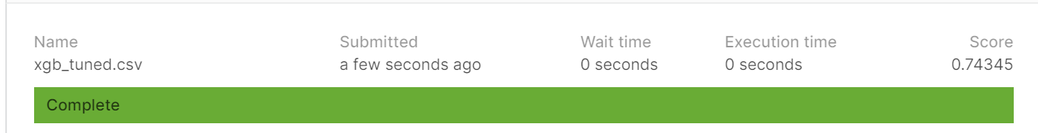
Findings
XGBOOST with hyper parameter tuning using randomized search performed the best(score=0.74345).
In the below table some of the scores obtained during the challenge
Algorithm | Score
Logistic Regression | 0.72066
Logistic Regression + PCA | 0.72931
Logistic Regression + PCA + SMOTE | 0.68744
Naïve Bayes | 0.63
Random Forest | 0.7
XGBOOST tuned using randomized search and self imputed | 0.74345
LightGBM | 0.72335

Slide 9
Thank You

